Slide 2
Absence of Copyright
This slideshow contains photos, diagrams, and information, some of which were attained through internet searches of public websites. The author of this presentation does not own the copyright on this information, so this slideshow is for personal use only—not for sale or profit. Please utilize it to seek the Lord and grow in your knowledge of His Word and ways.
Bro Stan’s Revelation Study is available on our church website:
www.faithprinceton.org

Slide 4
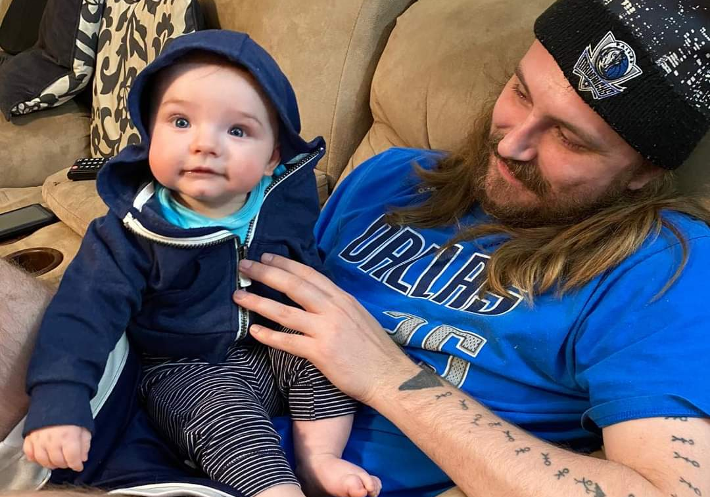
More Noah...
...and Josh

Slide 5
Prayer and Announcements
Sunday, October 4th:
7:30 Men’s Breakfast
9:15 Small Group Sunday School Classes
begin again! (Kids class and nursery)
10:30 Worship with a
Celebration of the Lord’s Supper

Slide 7
END HERE SEPTEMBER 30, 2020
LAST WEEK 19 Revelation 13
The Rise of the Beasts
THIS WEEK 20 Revelation 13 b
The False Prophet and the Mark of the Beast

Slide 8
Revelation 13 The Beast and the False Prophet
Notes:
Leon Morris, Tyndale Commentary on Revelation
13:1-18 The antichrist and his prophet The dragon, in his determination to annihilate the church, calls to his aid not one helper but two. The first beast comes out of the sea (1) showing its character as a sea monster like the dragon himself, and therefore demonic. The second beast comes out of the earth (11). This difference corresponds to that between behemoth the land monster (Jb. 40:15-24) and leviathan the sea monster (Jb. 41); in the prophetic and apocalyptic literature these creatures typify God–opposing powers (see e.g. Is. 27:1; 51:9; Ezk. 32). Consonant with this, the dragon, the beast from the sea and the beast from the land form a kind of evil trinity (see 16:13). Satan claims to be God; the antichrist is the christ of Satan; and the beast from the earth performs the function of an unholy spirit. The antichrist persuades the world to worship the devil; he has a fatal wound but lives (3), in a monstrous imitation of the Christ of God. The second beast seeks to persuade the world to worship the antichrist by his witness in word and deed, as the Holy Spirit witnesses to God’s Christ; and through the mark of the beast (itself a parody of the seal of God) he creates a devilish imitation of the church of Christ. So John depicts the world as divided between followers of the Truth and followers of the Lie.
8 The reference of the words from the creation of the world is uncertain; they can be linked with the slaying of [p. 1442] the Lamb (as in the AV, RV and NIV) or with the writing of names in the book of life (as in the JB, NASB and NRSV). Both meanings are equally true; for the former cf. 1 Pet. 1:19-20; for the latter Eph. 1:4. The difficulty is settled for most by appeal to 17:8, where almost identical language is used, linking the phrase with the writing in the book. Nevertheless, the word order here does not favour this interpretation, and it is best to keep to the NIV.

Slide 9
Revelation 13:11-12 The False Prophet
11 Then I saw another beast coming up out of the earth; and he had two horns like a lamb and he spoke as a dragon. 12 He exercises all the authority of the first beast in his presence. And he makes the earth and those who dwell in it to worship the first beast, whose fatal wound was healed.
Notes:
Exercises all the authority.... Makes all worship the first beast ➔ one-world religion / church
MORE COUNTERFEITING:
Like a lamb... ➔ more counterfeiting of the Holy !!! Looks like a lamb, but talks like a dragon
Whose fatal wound was healed... ➔ counterfeiting the resurrection of Jesus
Tyndale, Leon Morris
He is less fearsome, for he has but two horns whereas the first had ten, and seven heads besides (v. 1). Like a lamb (cf. Matt. 7:15) seems to be a parody of Christ which is further brought out when this beast is called ‘the false prophet’ (16:13; 19:20; 20:10). It is possible also that we should understand the two (of the horns) as in contrast with the two witnesses (ch. 11). All in all this beast looks like a dreadful parody of the truth. He spoke like a dragon; his speech resembles that of the evil one.
Called “another beast” here, but later called the “false prophet”
Rev. 16:13 And I saw coming out of the mouth of the ªdragon and out of the mouth of the ^{b}beast and out of the mouth of the ^{c}false prophet, three ^{d}unclean spirits like ^{e}frogs;
Rev. 19:20 And the beast was seized, and with him the ªfalse prophet who ^{b}performed the signs ^{1c}in his presence, by which he ^{d}deceived those who had received the ^{e}mark of the beast and those who ^{f}worshiped his image; these two were thrown alive into the ^{g}lake of ^{h}fire which burns with ²brimstone.
Rev. 20:10 And ªthe devil who ªdeceived them was thrown into the ^{b}lake of fire and ¹brimstone, where the ^{c}beast and the ^{c}false prophet are also; and they will be ^{d}tormented day and night forever and ever.

Slide 10
Revelation 13:13-15 The Great Deception
13 He performs great signs, so that he even makes fire come down out of heaven to the earth in the presence of men. 14 And he deceives those who dwell on the earth because of the signs which it was given him to perform in the presence of the beast, telling those who dwell on the earth to make an image to the beast who had the wound of the sword and has come to life....
Notes:
13 Performs great signs ➔ more counterfeit... fakes the work of the Holy Spirit
14 deceives... because of the signs given him to perform
14. By his miracles he deceives people and establishes his position. The inhabitants of the earth in this book seems to mean unregenerate mankind (see note on 6:10). The beast can deceive only unbelievers. There is an important spiritual truth here. If anyone serves God with all his heart he will not be taken in by the empty miracles of the deceiver. But one who turns from God predisposes himself to believe the lies of the second beast.

Slide 11
Revelation 13:13-15 cont. The Great Deception
15 And it was given to him to give breath to the image of the beast, so that the image of the beast would even speak and cause as many as do not worship the image of the beast to be killed.
Notes:
15 Given him to give breath➔ more counterfeit... Impersonating the resurrection of Jesus
martyrdom for those who not worship the image of the beast !!!
Are we willing to die for our faith???
the image of the beast Matthew 24:15-16 Jesus referred to “the abomination of desolation, spoken of by Daniel the prophet, stand in the Holy Place (whoso readeth, let him understand) then let them which be in Judaea flee into the mountains”
2 Thessalonians 2 ➔

Slide 12
The Great Deception ➔ Mark 13:22
v. 13 Performs great signs...
v. 14 ...deceives ...because of the signs given him to perform
➔ more counterfeit... fakes the work of the Holy Spirit
Mark 13:22 ...for false Christs and false prophets will arise, and will show signs and wonders, in order to lead astray, if possible, the elect.
Notes:
Tyndale, Morris
14. By his miracles he deceives people and establishes his position. The inhabitants of the earth in this book seems to mean unregenerate mankind (see note on 6:10). The beast can deceive only unbelievers. There is an important spiritual truth here. If anyone serves God with all his heart he will not be taken in by the empty miracles of the deceiver. But one who turns from God predisposes himself to believe the lies of the second beast.
Mark 13 and 2 Thessalonians 2 ➔

Slide 13
The Great Deception ➔ 2 Thessalonians 2:1-12
1 Now we request you, brethren, with regard to the coming of our Lord Jesus Christ and our gathering together to Him, 2 that you not be quickly shaken from your composure or be disturbed either by a spirit or a message or a letter as if from us, to the effect that the day of the Lord has come. 3 Let no one in any way deceive you, for it will not come unless the apostasy comes first, and the man of lawlessness is revealed, the son of destruction, 4 who opposes and exalts himself above every so-called god or object of worship, so that he takes his seat in the temple of God, displaying himself as being God. 5 Do you not remember that while I was still with you, I was telling you these things? 6 And you know what restrains him now, so that in his time he will be revealed.
Notes:
13 Performs great signs ➔ more counterfeit
14 deceives... because of the signs given him to perform
2 Thessalonians 2

Slide 14
The Great Deception ➔ 2 Thessalonians 2:1-12
7 For the mystery of lawlessness is already at work; only he who now restrains will do so until he is taken out of the way. 8 Then that lawless one will be revealed whom the Lord will slay with the breath of His mouth and bring to an end by the appearance of His coming; 9 that is, the one whose coming is in accord with the activity of Satan, with all power and signs and false wonders, 10 and with all the deception of wickedness for those who perish, because they did not receive the love of the truth so as to be saved. 11 For this reason God will send upon them a deluding influence so that they will believe what is false, 12 in order that they all may be judged who did not believe the truth, but took pleasure in wickedness.
Notes:
13 Performs great signs ➔ more counterfeit
14 deceives... because of the signs given him to perform
2 Thessalonians 2
1 Now we request you, brethren, with regard to the coming of our Lord Jesus Christ and our gathering together to Him, ² that you not be quickly shaken from your composure or be disturbed either by a spirit or a message or a letter as if from us, to the effect that the day of the Lord has come. ³ Let no one in any way deceive you, for it will not come unless the apostasy comes first, and the man of lawlessness is revealed, the son of destruction, ⁴ who opposes and exalts himself above every so-called god or object of worship, so that he takes his seat in the temple of God, displaying himself as being God. ⁵ Do you not remember that while I was still with you, I was telling you these things? ⁶ And you know what restrains him now, so that in his time he will be revealed. ⁷ For the mystery of lawlessness is already at work; only he who now restrains will do so until he is taken out of the way. ⁸ Then that lawless one will be revealed whom the Lord will slay with the breath of His mouth and bring to an end by the appearance of His coming; ⁹ that is, the one whose coming is in accord with the activity of Satan, with all power and signs and false wonders, ¹⁰ and with all the deception of wickedness for those who perish, because they did not receive the love of the truth so as to be saved. ¹¹ For this reason God will send upon them a deluding influence so that they will believe what is false, ¹² in order that they all may be judged who did not believe the truth, but took pleasure in wickedness.

Slide 15
Revelation 13:16-17 The Mark of the Beast
16 And he causes all, the small and the great, and the rich and the poor, and the free men and the slaves, to be given a mark on their right hand or on their forehead, 17 and he provides that no one will be able to buy or to sell, except the one who has the mark, either the name of the beast or the number of his name.
Notes:
ALL... the small and the great, and the rich and the poor, and the free men and the slaves
TO BE GIVEN A MARK
NO ONE WILL BE ABLE TO BUY OR SELL
NAME OR NUMBER OF THE BEAST ➔ ➔

Slide 16
Revelation 13:16-17 The Mark of the Beast
16 ALL... the small and the great, and the rich and the poor, and the free men and the slaves
No more separation of church and state!!!
in our day, preparation for this???
People being sued over religious convictions of whom they will serve (florist, bakery, etc.)
Marginalization of Christianity
NATO... WHO...
Notes:
ALL... the small and the great, and the rich and the poor, and the free men and the slaves
No more separation of church and state!!!
in our day, preparation for this... people being sued over religious convictions of who they will serve (florist, bakery, etc.)

Slide 17
Revelation 13:16-17 The Mark of the Beast
a mark on their right hand or on their forehead
The word “mark” refers to an impression or engraving.
On right hand or forehead makes it obvious who has it and who does not
COUNTERFEIT OF SEAL OF THE SPIRIT??? PHYLACTERIES??
Notes:
TO BE GIVEN A MARK
The word “mark” refers to an impression or engraving. Might be a brand like on animals? Tattoo?
on right hand or forehead makes it obvious who has it and who does not
Epp “so won’t be a credit card you can hide in your wallet.” ...Has to be out in the open where it can be seen –
*** (not an unseen microchip???) UNLESS scanners detect it???
COUNTERFEIT OF PHYLACTERIES?? AND SEAL OF THE SPIRIT???
Tyndale, Morris
It may also be meant as a travesty of the Jewish custom of wearing phylacteries (little boxes containing extracts from the Bible) on the left hand (or forearm) and on the head. It is probably also a parody of God’s seal (7:3; 14:1). ...

Slide 18
Revelation 13:16-17 The Mark of the Beast
Different Marks in NT Times: (Barclay)
Slaves? ➔ property of the beast
Soldiers? ➔ loyalty
Contracts? ➔ accept the law and authority
Coinage? ➔ property; citizens; currency
Certificate of sacrifice? ➔ worshipper / denier
Notes:
TO BE GIVEN A MARK
. It is probably also a parody of God’s seal (7:3; 14:1). ...
Barclay sees several possibilities:
if from the branding of domestic slaves, ‘it means that those who worship the beast are the slaves, the property of the beast’;
if from the custom of soldiers branding themselves with the name of a favourite general, ‘it means that those who worship the beast are the devoted followers of the beast’;
if from the use of sealing contracts, ‘it will mean that those who worship the beast accept the law and the authority of the beast’;
if from the mark stamped on coinage, ‘it will again mean that those who bear it are the property of the beast’;
if from the certificate that a man had sacrificed to Caesar, ‘the mark of the beast may be the certificate of worship, which a Christian could only obtain at the cost of denying his faith and being false to his Lord. Once he had that certificate he was labeled as a worshipper of Caesar and a denier of Christ.’

Slide 19
Revelation 13:16-17 The Mark of the Beast
17 ...NO ONE WILL BE ABLE TO BUY OR SELL
Commands allegiance to the Beast!!!
To receive the mark and utilize in business, one has to blaspheme God and worship the beast
join the movement?
support the new world government?
quit one’s own faith?
Notes:
NO ONE WILL BE ABLE TO BUY OR SELL
Commands allegiance to the Beast!!!
To receive and utilize in business, one has to blaspheme God and worship the beast (join the movement? support the new world government? quit their faith?)
Tyndale, Morris
The purpose, (so that; Gk. hina) of the mark is that no-one should engage in trade without it. Could (dynētai) is stronger than ‘hinder’ or the like. It points to a total prohibition, which would make it impossible for people without the mark to buy even necessities like food. It is thus impossible for those who oppose the beast even to live.
*** By the way.... We should notice the one world government and/or religion developments, but we are not called to fight them from happening... We should warn people about the deception and devastation it will bring and point them to the Kingdom of God...
BUT God has already said it WILL HAPPEN! Don’t be afraid... Trust God!!! Stay true and loyal to Him every day. STUDY THE BIBLE so you will be prepared!!!
NAME OR NUMBER OF THE BEAST ➔ ➔

Slide 20
Revelation 13:17-18 His Number is 666
17 and he provides that no one will be able to buy or to sell, except the one who has the mark, either the name of the beast or the number of his name. 18 Here is wisdom. Let him who has understanding calculate the number of the beast, for the number is that of a man; and his number is six hundred and sixty-six.
What is the “mark of the beast”????
Notes:
Name of the beast or the number of his name
WISDOM... UNDERSTANDING...
These are Gifts of God for His children... granted to believers by the power of the Holy Spirit!!
WE WILL KNOW!!

Slide 21
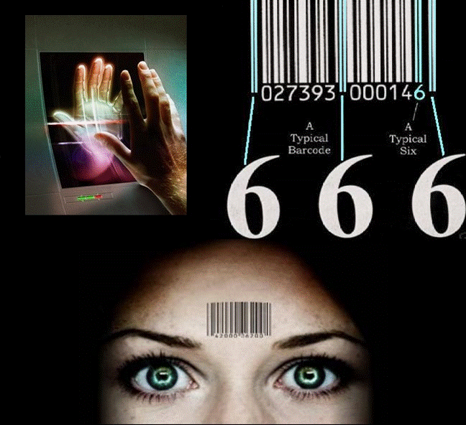
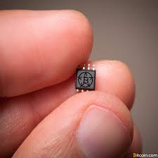
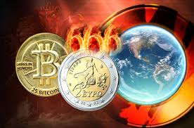
What is the “mark of the beast”????
Notes:
We don’t know!!! But we should not be afraid!!!
It will be a man thing... But we are God’s people!!

Slide 22
Revelation 13:8 His Number is 666
18 ...calculate the number of the beast,
for the number is that of a man; and his number is
six hundred and sixty-six.
Number of man
Falls short of the Divine = 777
Jesus = 888
Requires worship and blasphemy!!
DON’T BE AFRAID!!!
Notes:
CALCULATE THE NUMBER = THAT OF A MAN = 666
It will be a man thing... But we are God’s people!!
Involves false worship and blasphemy!!
Tyndale, Morris
Many numerical attempts have been made to match the number 666 to numerology (Nero, Roman empire, Hitler, etc.) by utilizing Hebrew, or Greek letters for numbers... BUT...
It is possible that such solutions are on the wrong lines and that we should understand the expression purely in terms of the symbolism of numbers. If we take the sum of the values represented by the letters of the name Iēsous, the Greek name ‘Jesus’, it comes to 888; each digit is one more than seven, the perfect number. But 666 yields the opposite phenomenon, for each digit falls short. The number may be meant to indicate not an individual, but a persistent falling short. All the more is this likely to be correct if we translate ‘it is the number of man’ rather than ‘a man’. John will then be saying that unregenerate man is persistently evil. He bears the mark of the beast [Vol 20: Rev, p. 169] in all he does. Civilization without Christ is necessarily under the dominion of the evil one.

Slide 23
We are already sealed ...
Rev 7:1-8 Do not harm the earth or the sea or the trees until we have sealed the bond-servants of our God on their foreheads. (144,00 sealed)
Rev 9:4 the locusts were told not to hurt the grass of the earth, nor any green thing, nor any tree, but only the men who do not have the seal of God on their foreheads.
Rev 14:1 Then I looked, and behold, the Lamb was standing on Mount Zion, and with Him 144,000, having His Name and the Name of His Father written on their foreheads.
Notes:
CALCULATE THE NUMBER = THAT OF A MAN = 666
Number of man
Falls short of the Divine = 777
requires worship and blasphemy!!
We are already sealed ...
Rev 7:1-8 Do not harm the earth or the sea or the trees until we have sealed the bond-servants of our God on their foreheads. (144,00 sealed)
Rev 9:4 the locusts were told not to hurt the grass of the earth, nor any green thing, nor any tree, but only the men who do not have the seal of God on their foreheads.
Rev 14:1 Then I looked, and behold, the Lamb was standing on Mount Zion, and with Him 144,000, having His Name and the Name of His Father written on ttheir foreheads.
Rev 14:9-10 Then another angel, a third one, followed them, saying with a lound voice, “If anyone worships the beast and his image, and receives a mark on his forehead or on his hand, he also will drink of the wine of the wrath of God, which is mixed in full strength in the cup of His anger; and he will be tormented with fire and brimstone in the presence of the holy angels and in the presence of the Lamb....
Rev 20:4 thrones in the millennial kingdom for those who did not worship the beast... nor received the mark on their foreheads or hands
Rev 22:4 they will see His face, and His name will be on their foreheads.

Slide 24
WARNING against receiving the mark...
Rev 14:9-10 Then another angel, a third one, followed them, saying with a loud voice, “If anyone worships the beast and his image, and receives a mark on his forehead or on his hand, he also will drink of the wine of the wrath of God, which is mixed in full strength in the cup of His anger; and he will be tormented with fire and brimstone in the presence of the holy angels and in the presence of the Lamb....
Notes:
Rev 14:9-10 Then another angel, a third one, followed them, saying with a lound voice, “If anyone worships the beast and his image, and receives a mark on his forehead or on his hand, he also will drink of the wine of the wrath of God, which is mixed in full strength in the cup of His anger; and he will be tormented with fire and brimstone in the presence of the holy angels and in the presence of the Lamb....
Worshipping the beast goes with receiving the mark!!!

Slide 25
Rewards are coming...
Rev 20:4 ... thrones in the millennial kingdom for those who did not worship the beast... nor received the mark on their foreheads or hands
Rev 22:4 they will see His face, and His name will be on their foreheads.
DO NOT BE AFRAID!!!
Notes:
CALCULATE THE NUMBER = THAT OF A MAN = 666
Number of man
Falls short of the Divine = 777
requires worship and blasphemy!!
We are already sealed ...
Rev 7:1-8 Do not harm the earth or the sea or the trees until we have sealed the bond-servants of our God on their foreheads. (144,00 sealed)
Rev 9:4 the locusts were told not to hurt the grass of the earth, nor any green thing, nor any tree, but only the men who do not have the seal of God on their foreheads.
Rev 14:1 Then I looked, and behold, the Lamb was standing on Mount Zion, and with Him 144,000, having His Name and the Name of His Father written on ttheir foreheads.
Rev 14:9-10 Then another angel, a third one, followed them, saying with a lound voice, “If anyone worships the beast and his image, and receives a mark on his forehead or on his hand, he also will drink of the wine of the wrath of God, which is mixed in full strength in the cup of His anger; and he will be tormented with fire and brimstone in the presence of the holy angels and in the presence of the Lamb....
Rev 20:4 thrones in the millennial kingdom for those who did not worship the beast... nor received the mark on their foreheads or hands
Rev 22:4 they will see His face, and His name will be on their foreheads.

Slide 26
Revelation 14:1
Then I looked, and behold, the Lamb was standing on Mount Zion, and with Him 144,000, having His Name and the Name of His Father written on their foreheads.

